Slide 1
Surrey Through The Lens of Crime and Schools
Gus, Bintang and Jay

Slide 2

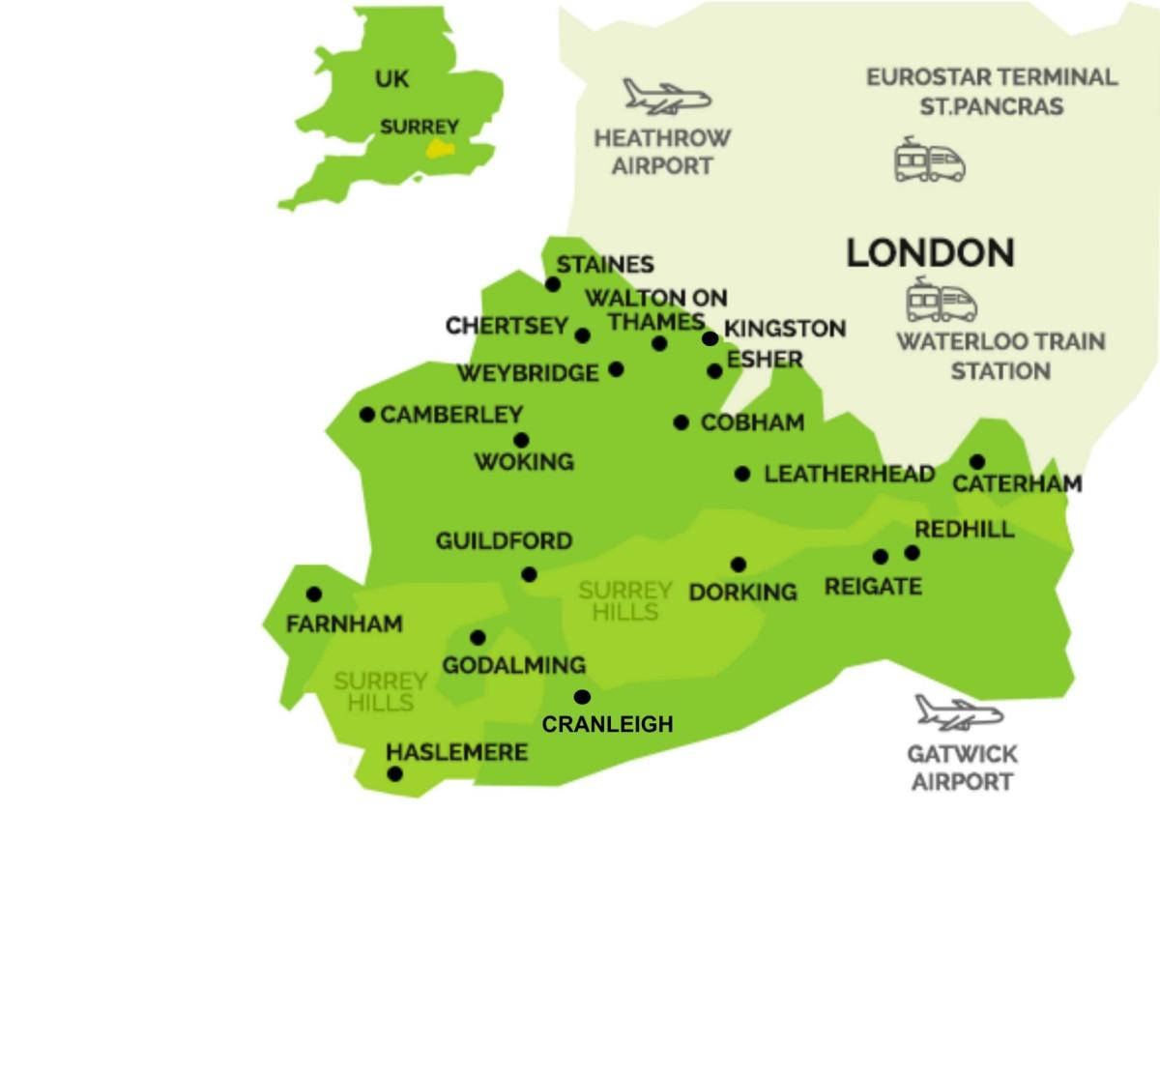
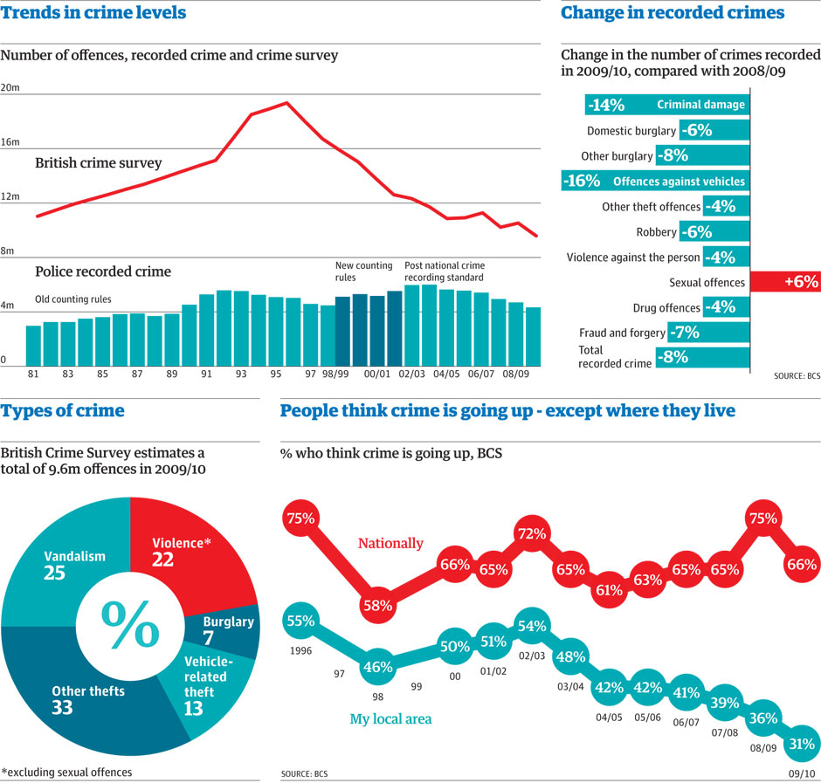
Background to the topic / question you are researching through your visualisation.
The topic that we will be researching will be the correlation between crime and the rates of education throughout surrey.
Ofstead is a government service which rates and reviews public schools across the country
Rating them from excellent to inadequate
We will be looking at the crime rates through a government providing information of crime rates through surrey
Our project will show an interactive map of Surrey where the viewer can see different parts of the county so they can see if there is any correlation between the standards of schools and crime.
Notes:
The topic that we will be researching will be the correlation between crime and the rates of education throughout surrey. We will be looking at the ofsted reports of schools around areas of surrey. Ofstead is a government service which rates and reviews public schools across the country. Rating them from excellent to inadequate. We will be comparing the rating of these schools compared to crime rates in areas around the schools. We will be looking at the crime rates through a government providing information of crime rates throughout surrey. As university students in Egham, crime and education levels throughout Surrey are important, as they impact their everyday lives. Our project will show an interactive map of Surrey where the viewer can see different parts of the county so they can see if there is any correlation between the standards of schools and crime. The website will also have text and other information including a key to understand the ofsted rating of schools. This shows the important information needed to understand our project on crime and schools across Surrey.

Slide 3
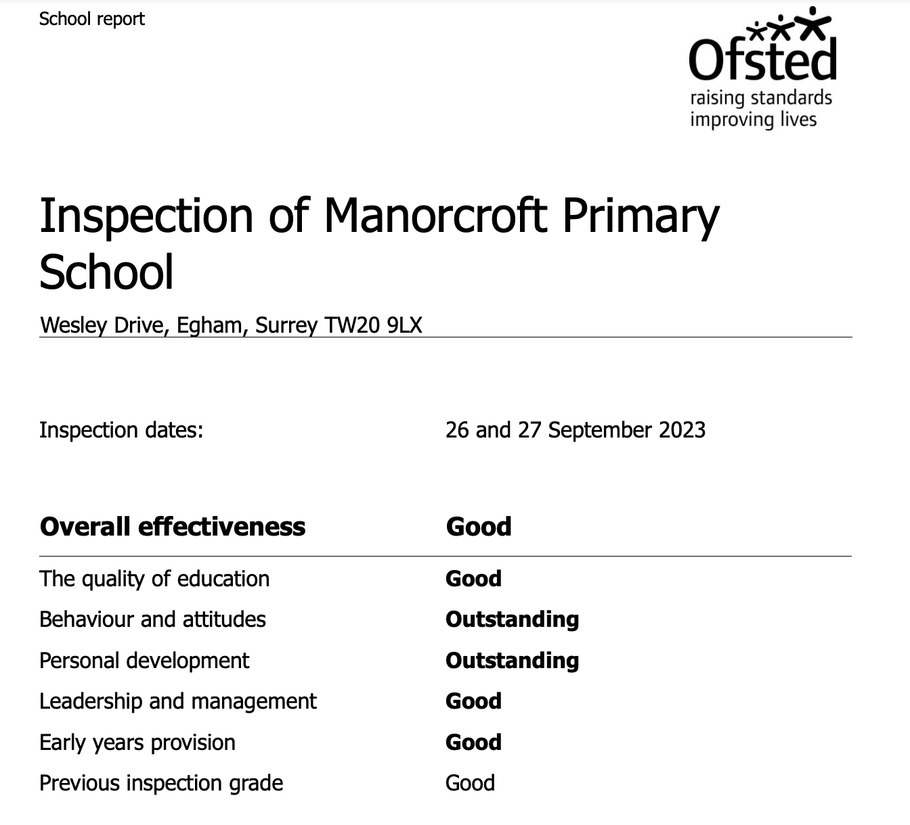
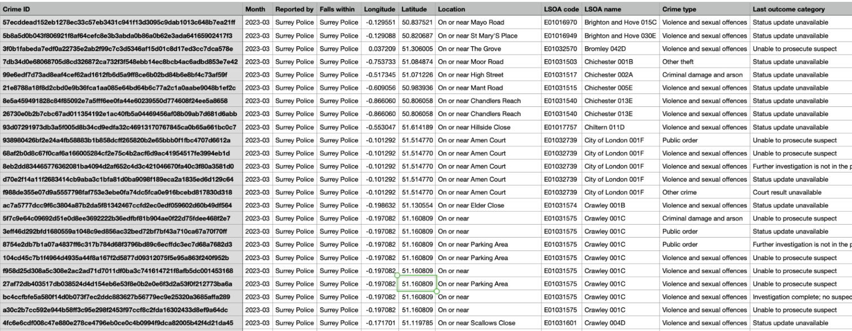
The datasets we will be working on
Introduce the dataset you will be working with.
Surrey police website
Ofsted schools report.
https://www.police.uk/pu/your-area/surrey-police/englefield-green/?yourlocalpolicingteam=about-us&tab=statistics
https://reports.ofsted.gov.uk/search?q=&location=Egham+TW20%2C+UK&lat=51.4243812&lon=-0.5586007&radius=3&level_1_types=0
Notes:
We will be using two data sets, as seen below. The first data set can be found on the surrey police website. This will help for our project as this can show crime rates in areas, it shows what the crime that has been committed, the location and time when the incident happened. This is important as this allows us to compare against the levels of education in the area.
As well as this, we will be using ofsted reports. These reports look like this. As said before. These reports rate schools from excellent to inadequate. The school is rated on different aspects of the school not just education. They can be rated on inclusitity just for example. This will help to understand the education levels and standard of schools in areas around surrey so we can compare them to crime rate so we can see if there is any correlation between the two.
https://www.locrating.com/school_catchment_areas.aspx?lat=51.43469&lng=-0.54559

Slide 4
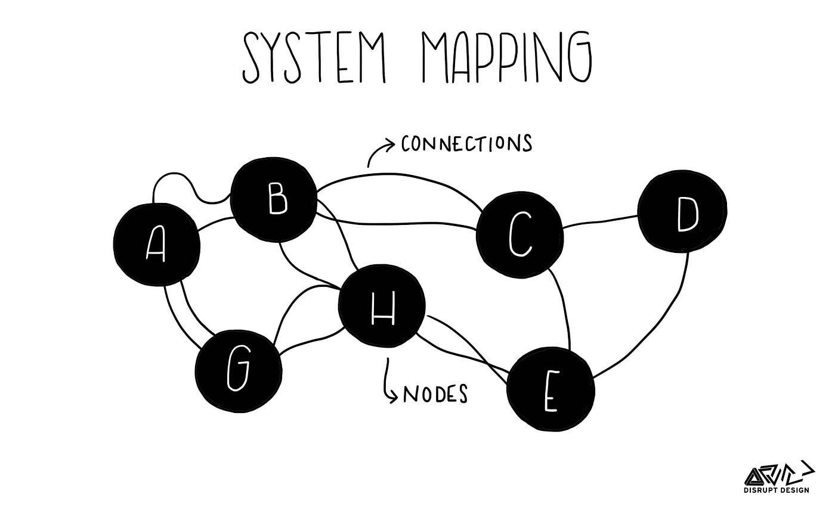

Critique of the dataset/project (cite/quote 1st source of relevant literature). You might discuss the limitations of the dataset.
‘What would a feminist open source investigation look like?’
“Outwardly, the language of verifcation matters greatly because of its effect on the integrity and persuasiveness of an investigation’s findings. As such, it should be treated with extreme care.”
One issue that we might face is how we group schools and crime reports together with police reports and the ofsted reports might use different mapping systems and therefore making it tricky to compare an area.
This shows why it is important to use clear language when conducting our findings and making our report.
Notes:
A quote I found that relates to our project, was found in the report ‘What would a feminist open source investigation look like?’ By Sophie Dyer and Gabriela Ivens
The quote states
“Outwardly, the language of verifcation matters greatly because of its effect on the integrity and persuasiveness of an investigation’s fndings. As such, it should be treated with extreme care.”
This shows that the language being used on a research project can change outcomes and perceptions of the project, so it is important to be clear while doing research and presenting the project.
This relates to the project that we have been doing. One issue that we might face is how we group schools and crime reports together with police reports and the ofsted reports might use different mapping systems and therefore making it tricky to compare an area. For example the school report could say one senior school is inside Guilford while the police report could say the area with the school is outside guilford. This shows why it is important to use clear language when conducting our findings and making our report. This is all important to have a accurate project.

Slide 5
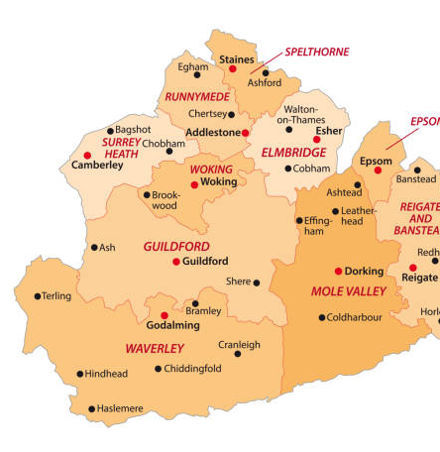
We are planning on creating a map of Surrey that will have interactive areas. These areas are:
Guildford
Farnham
Runnymede
Staines
Presented through bar graphs that indicate the ofsted reporting compared to the crime rate.
When you click on each of the areas above, you will be shown indicative data presenting the crime rates compared to the school Ofsted reports. This data will be shown through bar graphs.

Slide 6
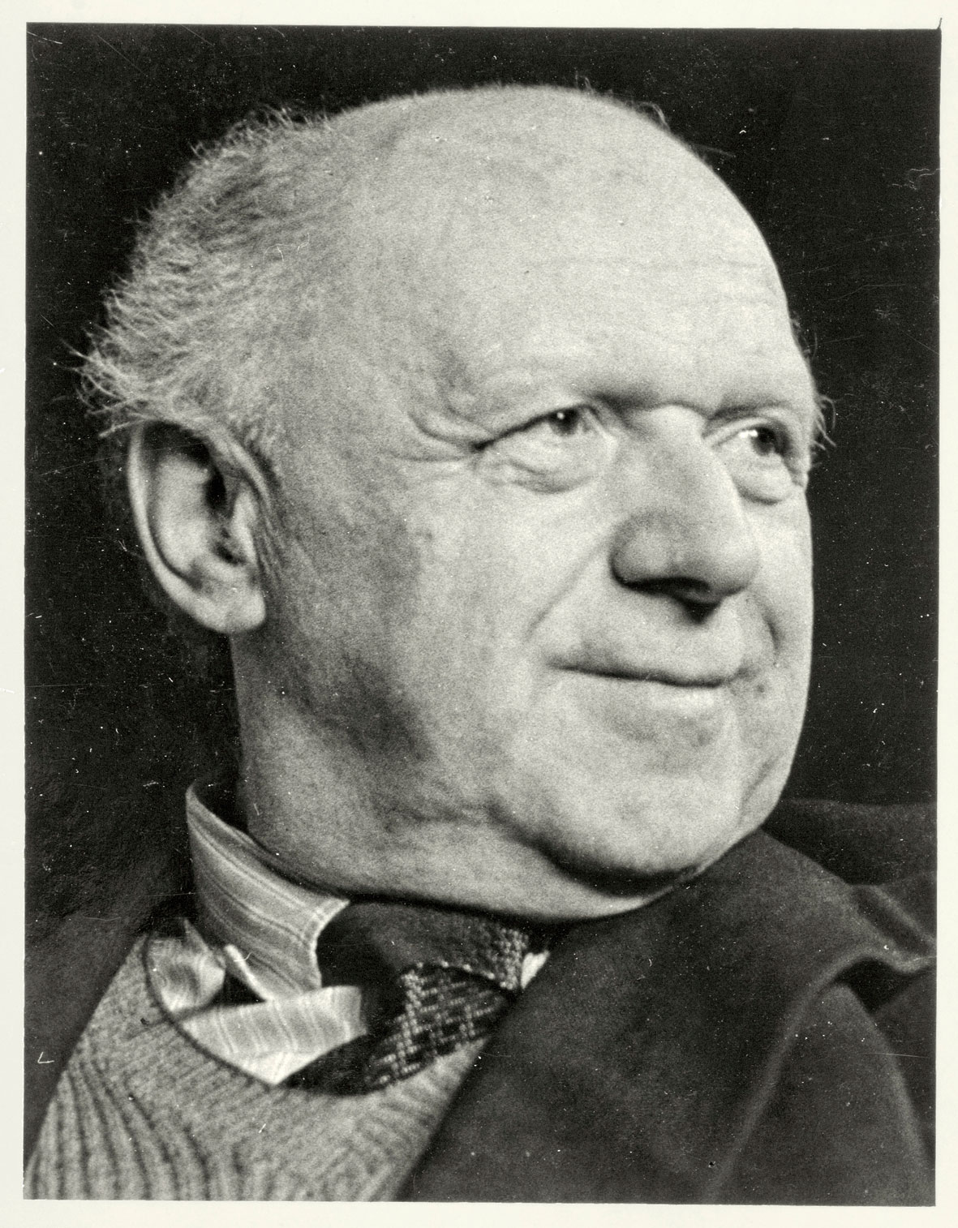
“In some ways Isotype offered an alternative to verbal language – ‘Words divide, pictures unite’ was one of Neurath’s catchphrases.”
(Isotype: Representing Social Trends Pictorially)

Slide 7
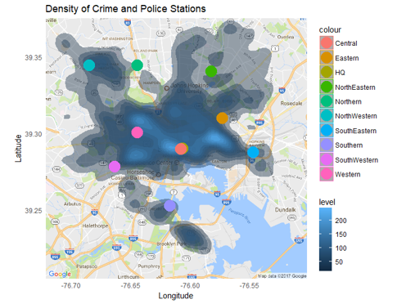
This map created at the University of Virginia by Julia Nguyen, Katherine Qian, Youbeen Shim and Catherine Sun, detailing crime and police stations in Baltimore.
We like the simplicity of it, it is easy to understand where the hotspots are within the city.
‘Words Divide, Pictures Unite’. This ethos from ‘Isotype: Representing Social Trends Pictorially’ is indicative of our goals in our project, to display our data in a way that is interesting and accessible.

Slide 8
Some of the issues we may encounter in the creation process:
The datasets are collected by county, and finding datasets of individual areas and arranging that data is difficult.
The data sets are of entire counties, so finding the different data for each is very difficult.
Coding a map and maintaining a UI that is concise, intuitive and easy to use.
Maintaining an informative mindset when discussing data from serious topics such as crime rates, without having bias or having an ‘angle’.
The datasets also include Police codes, which are illiterate and confusing to dissect. They look like this: 57ecddead152eb1278ec33c57eb3431c941f13d3095c9dab1013c648b7ea21ff

Slide 9
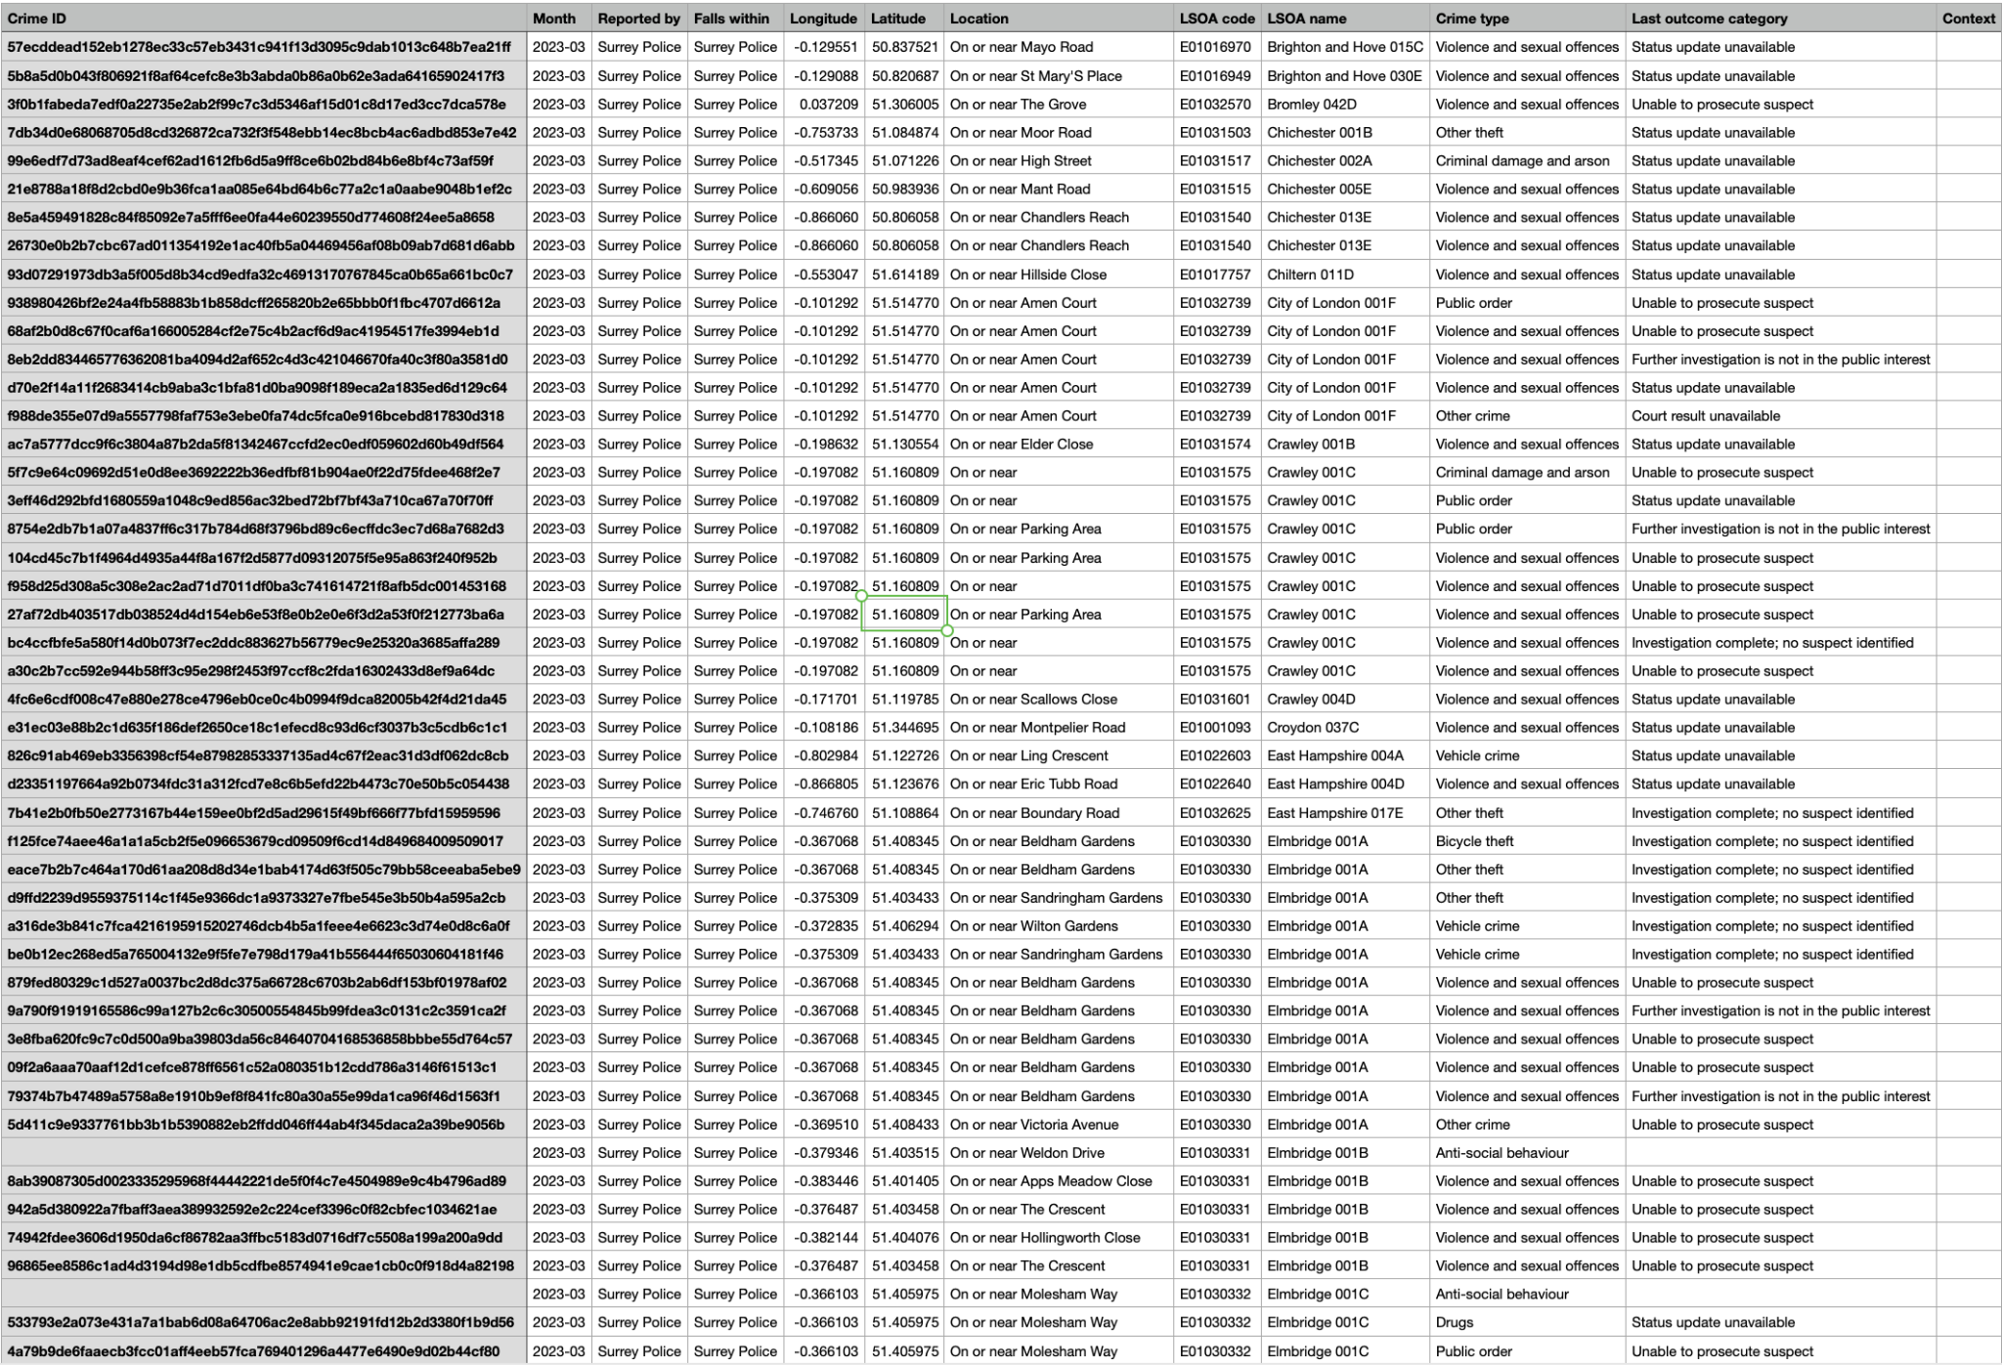

Slide 10
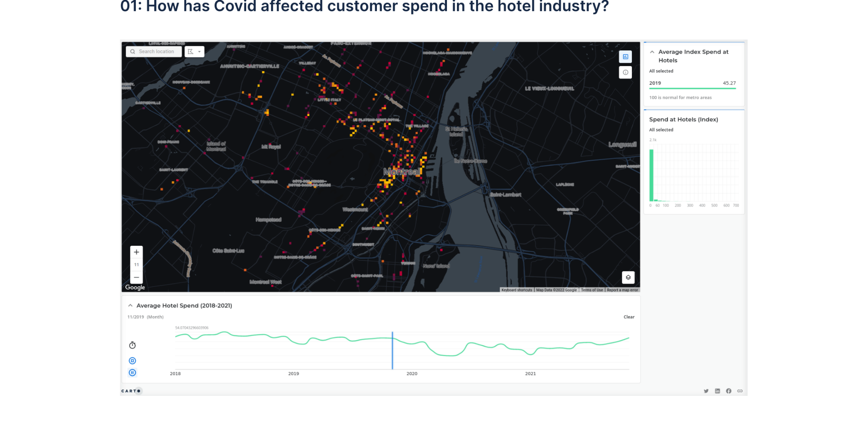
Technical Choices and Influences
Notes:
This is a visualisation by an Engineeer named Eva Estarada Adler which highlights the dip in consumer spending in hotel in the Montreal area from 2018 to 2021
We like the technical choices of this map visualisation since not only does it provide the hot spots of where people spend their money on hotel It also provide a time stampt at the bottom, where people can view the amount spend on different point of times
We feel that adding a time stampt will give our project a greater depth as we can see when school are developed and how the amount of crimes comitted in the area react accordingly
Thus if we can pull it off adding a time stampt will give our project a greater depth

Slide 11
Potential Issues of the project
Potential coding bugs
Some areas are reportedly more than others
Predictive Policing
Notes:
Potential coding bugs are always relevant in a coding project
Where the last problem may include the way in which the crimes are being reported

Slide 12
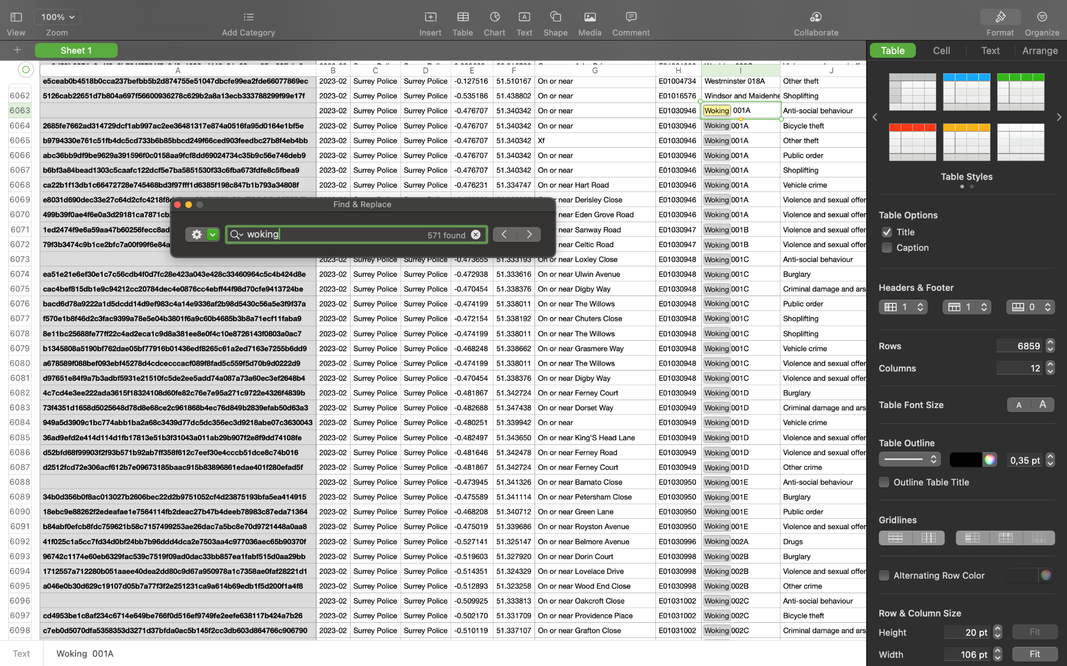

Slide 13
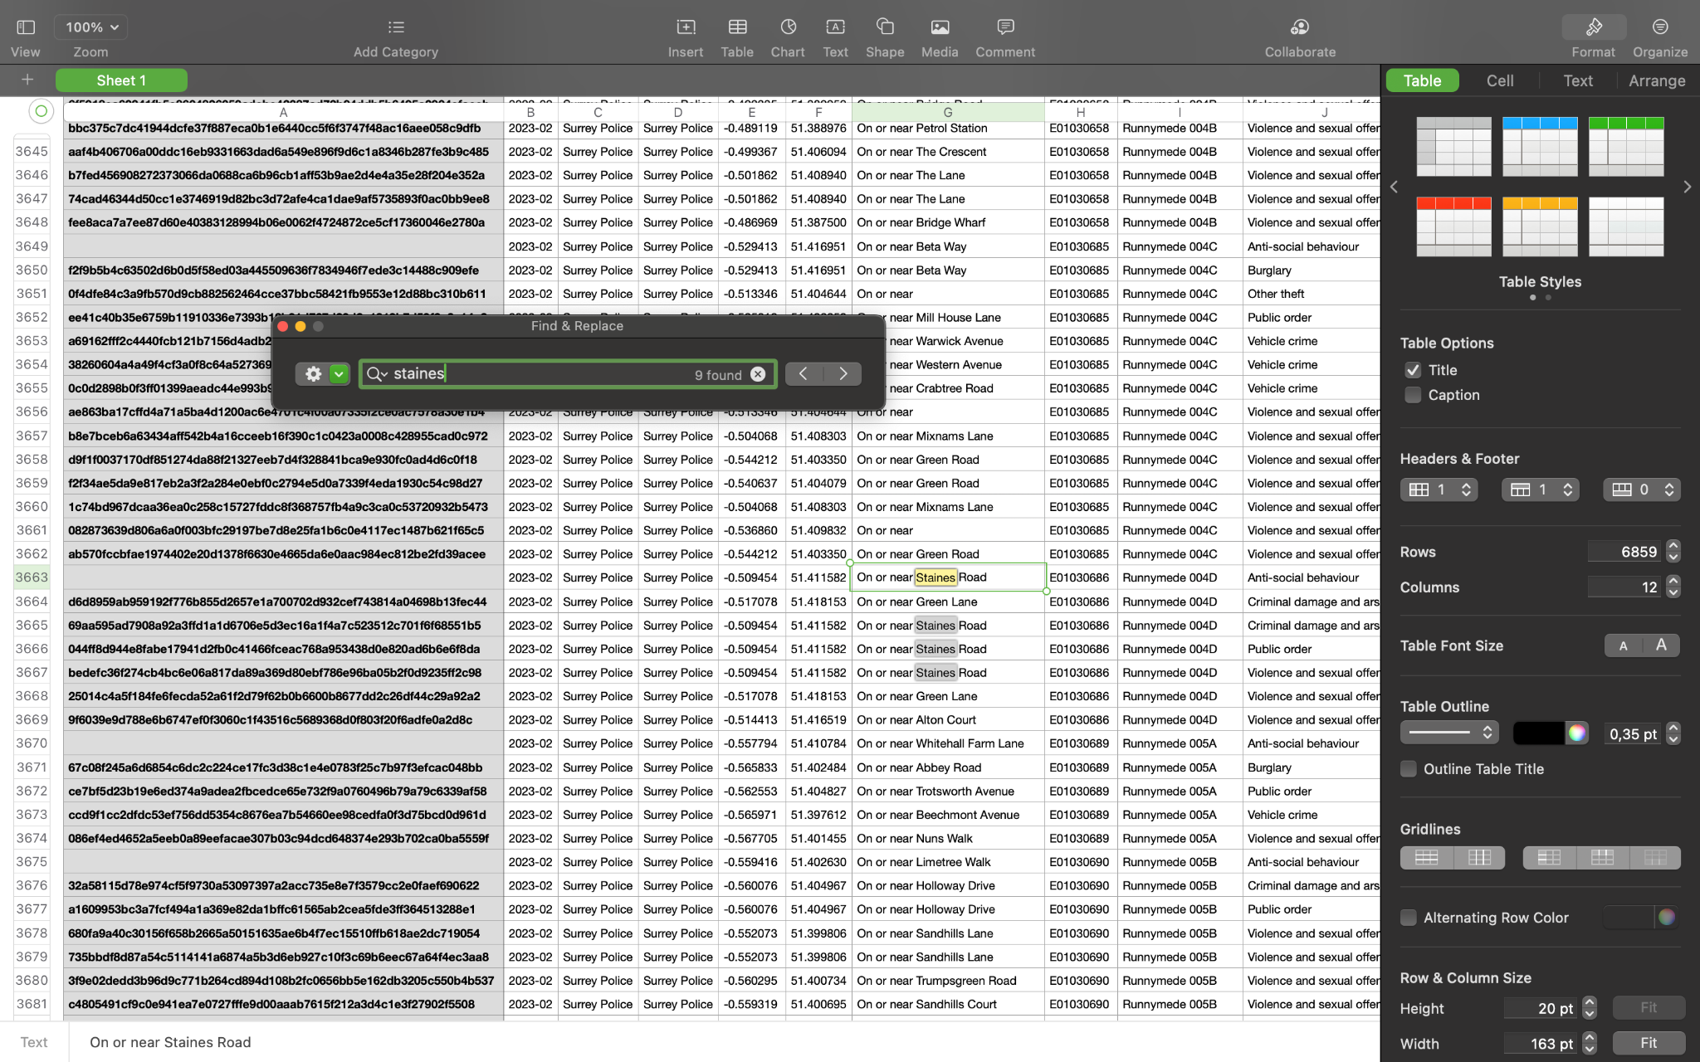
Notes:
Reasons for this inequality of data might be deeper than just different areas have lower crime rates, reports have also shown that police have been staying at the same place for a long period of time waiting for crime to happened, while other areas may not be monitored as heavily PREDICTIVE POLICING
Because of this we have to be really careful in reporting the data and make sure that we represent the people in the data as the link shows

Slide 14
Task Distribution
Gus - School Data Research
Bintang - Police Data Research
Jay - Coding and Design
Notes:
With task distribution we really just spread it on based what each of us is comfortable with
Gus for example goes to a school in the UK and several other countries like South Africa and Kenya thus we feel like he has a vasst understanding on the education system and will be the best at looking at the data
Whereas Jay is the most comfortable with coding out of the three of use, where obviously each of us will contribute to the code we will follow his guidance on how to do it
With myself, approaching this project as an international student I’m Just interested in how the police system works In the UK and how they report their data

